Slide 1
Network Measurement: Multiplexity and Multilayer Networks

Slide 2
Why multilayer networks?
So far we have dealt mainly with social networks that can be represented by simple graphs:
  G = (V, E)
    Where set E is composed of a single “type” of edge
However, human society is composed of people linked via a multiplicity of relations
  The multiplicity of relations is defined across a variety of role, sentiment, behavior, and exchange relations:
    Love, Friendship, Exchange, Enmity, collocation, etc.
Need a way to model this added layer of complexity

Slide 3
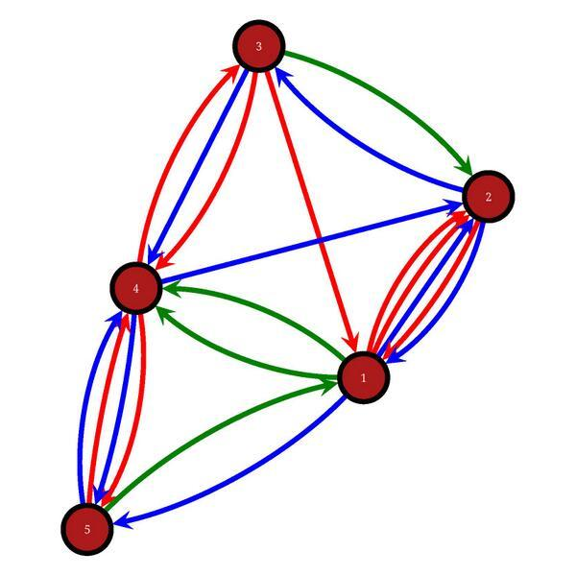
Multigraphs
In both directed and undirected graphs, the same vertices may be joined by more than one distinct edge
  These are called multigraphs
Multigraphs may be used to represent the social network concept of multiplexity
Multiplexity exist when persons have multiple relations relationships with one another
    e.g. a friend who is also an advisor who is also a member of your congregation

Slide 4
Why multilayer networks?
A multigraph can be thought of as a set of simple graphs “superimposed” on top of one another:
  G = (V, E₁), (V, E₂), (V, E₃), … (V, E_{m})
    A.K.A. multiplex, multirelational, multimodal, or multivariate graphs
Analytically we may be interested in possible patterns of dependence or constraint across different network “layers”
  Are different layers (positively, negatively) correlated?
    Are “friends” (role-relation) also more likely to communicate (exchange) and appear in the same place (behavior)?
  Does and edge in one layer “imply” the presence or absence of a link in the other?
    Does the presence of negative affect (sentiment) imply the absence of friendship (role-relation)?

Slide 5
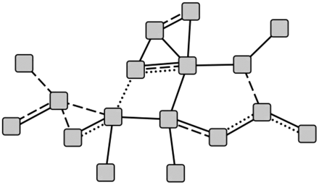
Types of ties in social networks
Role relations
  Friends, kin, business partners
Interpersonal sentiments and cognitions
  Liking, trusting, enmity
Behavioral interactions
  Calling, texting, citing
Social exchange
  Supporting, resource transfer

Slide 6

Types of ties in social networks

Slide 7
Multiplexity in sociology and anthropology
Mainly studied in the context of the co-presence of multiple role relations in a single relationship
  E.g. correlations between different role relations at the ego-level: Do friends tend to also be co-workers? (Verbrugge 1979)
  More recent work has extended the notion to the study of the link between multiple types of connectivity
    E.g. Role-relations + behavioral interaction
Classic work concerned itself with whether different types of role-relations concatenated into “systems”
  One role-relation logically implied another
  One role-relation was a sub or superset of another

Slide 8
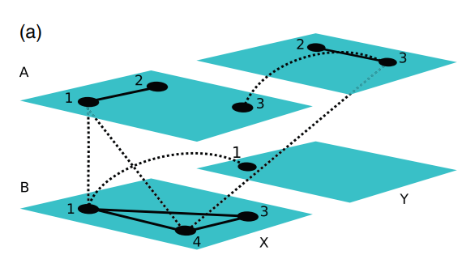
What is a multilayer network?
In most general form multilayer networks subsume temporal networks as a special case:
  Time (t) as a set of layers
Also need to specify sets of layers for “relation type,” location” or whatever
  A “layer” in a multilayer network is therefore a particular combination (n-tuple) of two or more of these aspects

Slide 9
What is a multilayer network?
Given this a multilayer network can be defined as a quadruple:
  M = (V, L, V_{M}, E_{M}, )
  Where
    V is the set of all possible combinations of nodes and layers
    V_{M} is the V subset of existing nodes and layers triplets
    E_{M} is a set of ordered pair of nodes across and within layers
    L is the set of all ordered pairs of layers: L = (time, relation-type)

Slide 10
What is a multilayer network?
In the most general case:
  Nodes can differ across time-type layers
  Edges can be:
    intra-layer
    Inter-layer
    Reflexive inter-layer edges are coupling edges
    Inter-layer edges make more substantive sense for the temporal aspect
  A graph can be defined for each type of edge

Slide 11
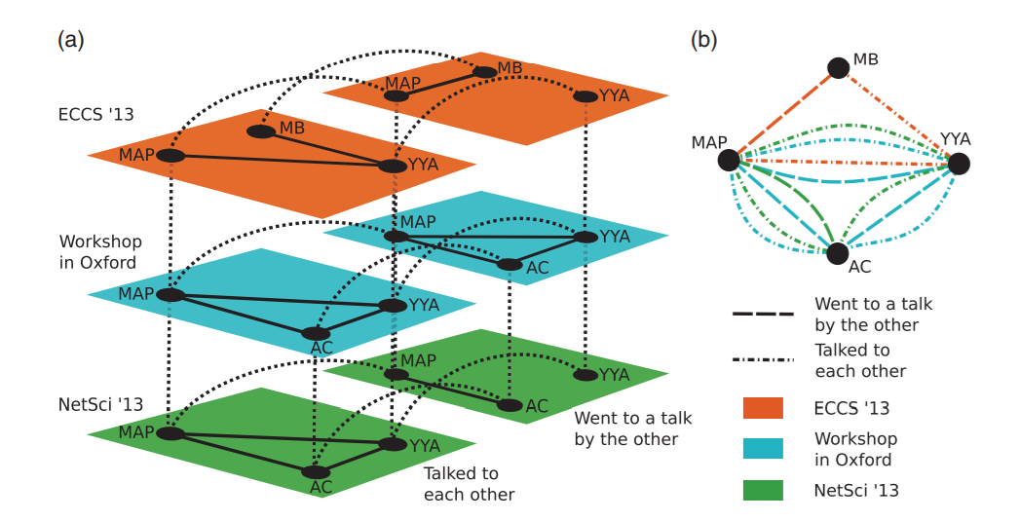
What is a multilayer network?
More familiar types of multilayer networks emerge from restrictions on the general case:
  Node aligned multilayer networks
    All layers contain the same nodes
  Layer-disjoint multilayer networks
    Each layer contains a unique set of nodes
  Diagonal multilayer networks
    All inter-layer edges are reflexive

Slide 12
What is a multilayer network?
More familiar types of multilayer networks emerge from restrictions on the general case:
  Node aligned multilayer networks
    All layers contain the same nodes
  Layer-disjoint multilayer networks
    Each layer contains a unique set of nodes
  Categorical multilayer networks
    All inter-layer edges are reflexive and are present

Slide 13
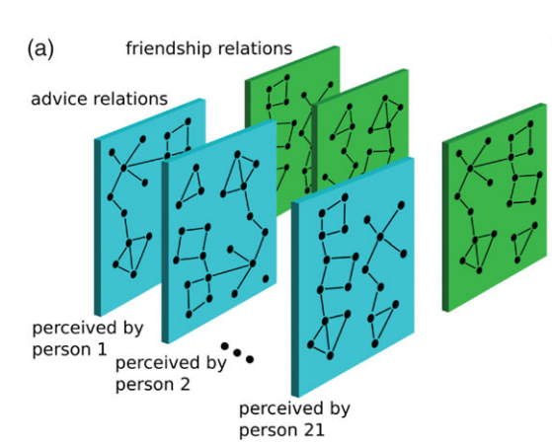
The supra-adjancency matrix representation
The supra-adjacency matrix representation is the multilayer analogue of the regular adjancecy matrix
In a node-aligned network with V vertices and ȴ total layers:
  the supra-adjancency matrix A is an ȴ x ȴ matrix of V x V blocks
  (A_{aa})_{ij} = 1 if i and j are adjacent in layer a
  (A_{ab})_{ii} = 1 if i is present in both a and b

Slide 14
The supra-adjancency matrix representation
Example: Krackhardt’s (1987) Cognitive Social Structures
  Each person is asked not just about their relations with other persons
  But also about their perception of the existence of relations between each other pair of people in the system
  This yields N matrices of perceived relations between all people
    One for each informant
  People report on multiple relations (R):
    Layers = N X R

Slide 15
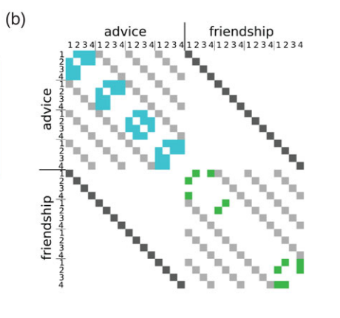
The supra-adjancency matrix representation
Example: Krackhardt’s (1987) Cognitive Social Structures
  Each person is asked not just about their relations with other persons
  But also about their perception of the existence of relations between each other pair of people in the system
  This yields N matrices of perceived relations beween all people
    One for each informant
  People report on multiple relations (R):
    Layers = N X R

Slide 16
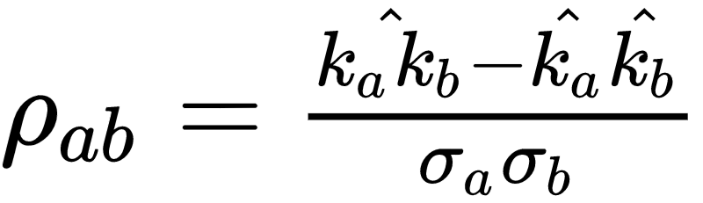
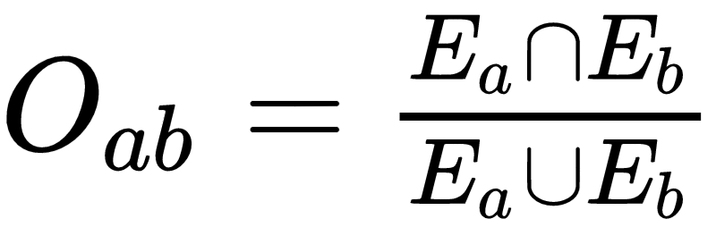
Multilayer network metrics
Multiplex intra-layer degree:
  k_{i} = {k_{i}(1), k_{i}(2), k_{i}(3),...k_{i}(m)}
  k_{i} = 𝚺_{m}k(m)
    Only makes sense in some applications
Cross-layer degree correlation:
Can also use rank-based correlations
Cross-layer edge overlap:

Slide 17
Research on multirelational networks
Szell, Lambiotte and Thurner:
  300,000 players of a massive multiplayer online game (MMOG)
  Multiple types of relations across players, Inclusive of:
    Communications (private messages)
    In-game “friendships” and cooperation
    In-game conflict: Attacks, fights, revenge, destruction of “property”
Basic patterns:
  Positive relations (whether role or exchange-based) tend to be reciprocal
    Negative relations are less reciprocal
  Degree distributions based on negative behavioral interactions (e.g. attack) have long tails
    Not the case for positive relations
  The “rich get richer” effect seems to governing negative behaviors
    “Pile on” for negative indegree

Slide 18
Research on multirelational networks
Szell, Lambiotte and Thurner:
  300,000 players of a massive multiplayer online game (MMOG)
  Multiple types of relations across players, Inclusive of:
    Communications (private messages)
    In-game “friendships” and cooperation
    In-game conflict: Attacks, fights, revenge, destruction of “property”
Basic patterns:
  Positive interaction layers have high clustering
    Negative interaction layers do not have high clustering
  Relations between different layers:
    Given by link overlap (Jaccard) and degree-degree (rank) correlations across layers

Slide 19
Research on multirelational networks
Szell, Lambiotte and Thurner:
  300,000 players of a massive multiplayer online game (MMOG)
  Multiple types of relations across players, Inclusive of:
    Communications (private messages)
    In-game “friendships” and cooperation
    In-game conflict: Attacks, fights, revenge, destruction of “property”
Basic patterns:
  The following layers have high overlap:
    Communication/friendship
    Trade/communication
    Enemy/attack
    Community/attack

Slide 20
Research on multirelational networks
Szell, Lambiotte and Thurner:
  300,000 players of a massive multiplayer online game (MMOG)
  Multiple types of relations across players, Inclusive of:
    Communications (private messages)
    In-game “friendships” and cooperation
    In-game conflict: Attacks, fights, revenge, destruction of “property”
Basic patterns:
  The following layers have low overlap:
    Friendship/attack
    Trade/attack
    Trade/enmity
  Players have high degree correlation across the friendship/enmity layers

Slide 21
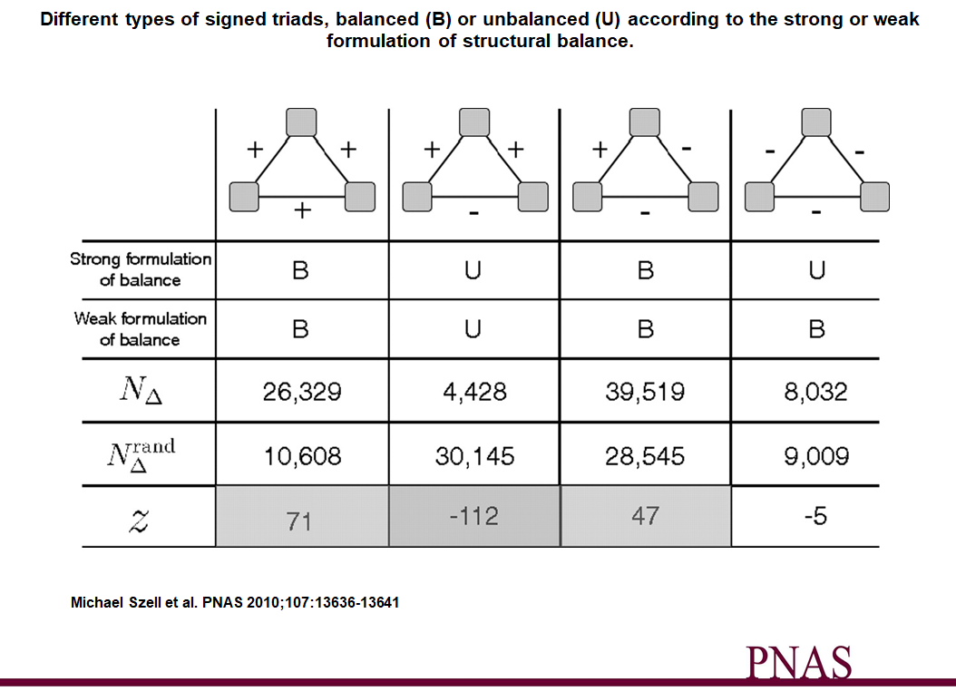

Slide 22
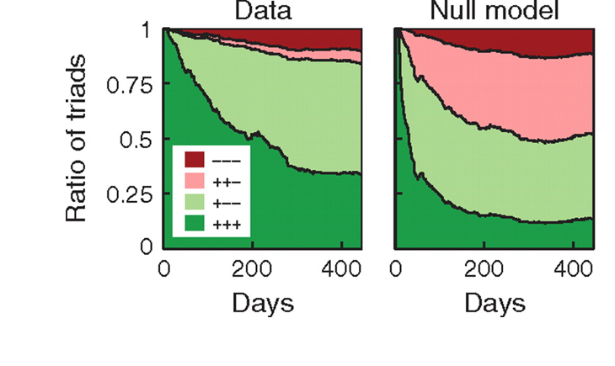

Slide 23
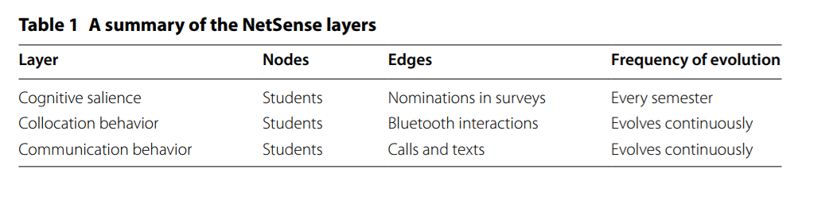
NetSense data as a multilayer network
Data collected as part of NetSense can be thought of as node-aligned multilayer network
  We may be interested in:
    Cross-layer correlations
    Cross-layer temporal dependence
    Cross-layer topological similarities and differences

Slide 24
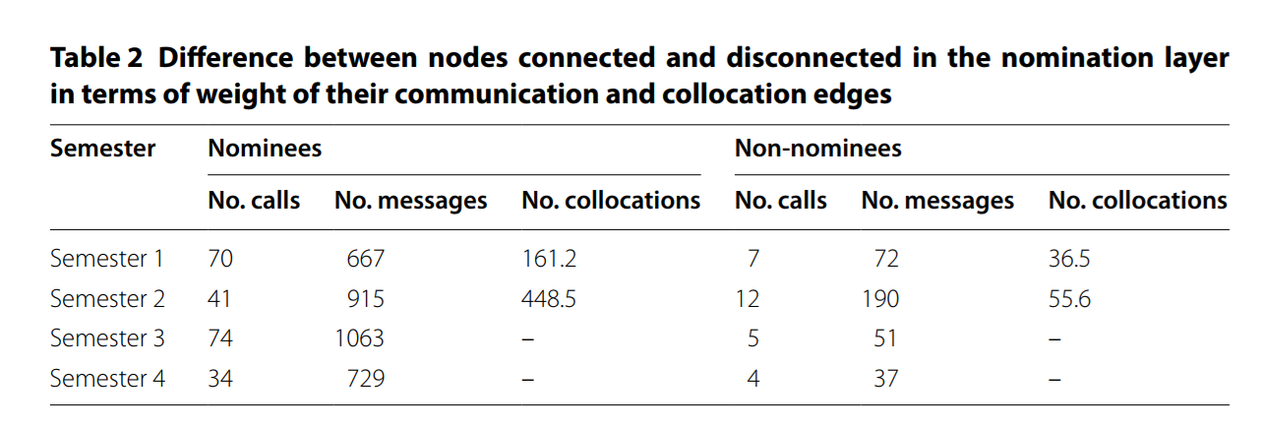
NetSense data as a multilayer network
Data collected as part of NetSense can be thought of as node-aligned multilayer network
  We may be interested in:
    Cross-layer correlations
    Cross-layer temporal dependence
    Cross-layer topological similarities and differences

Slide 25
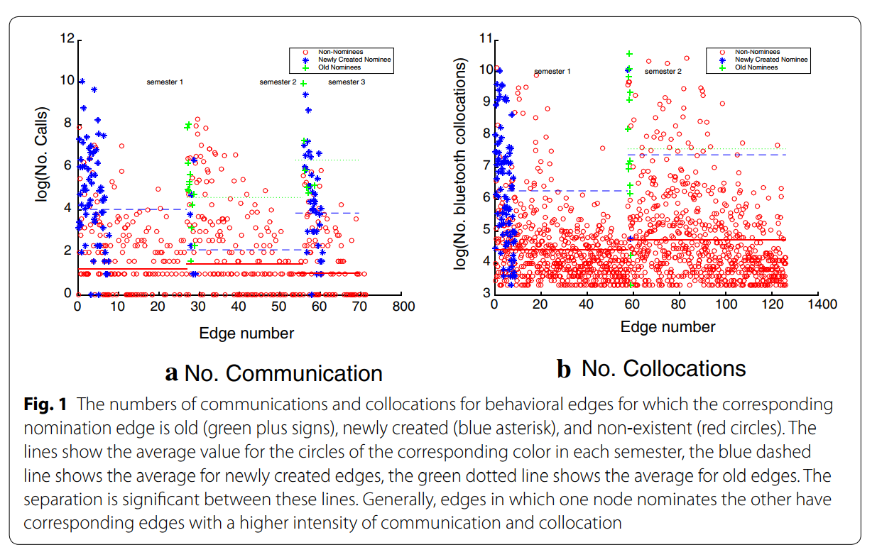
NetSense data as a multilayer network

Slide 26
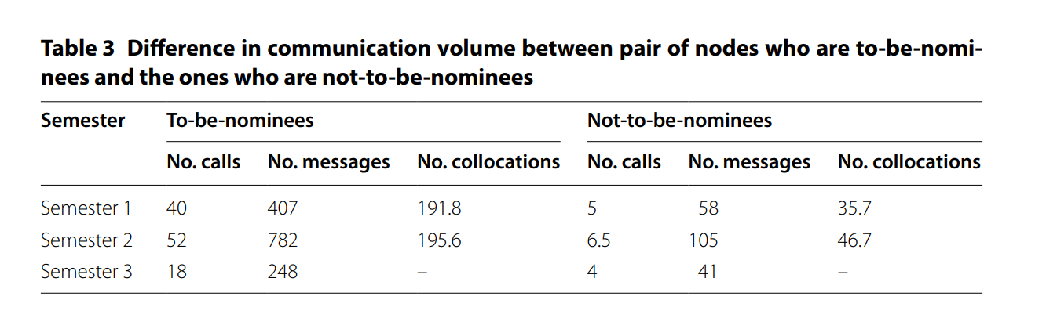
NetSense data as a multilayer network
Data collected as part of NetSense can be thought of as node-aligned multilayer network
  We may be interested in:
    Cross-layer correlations
    Cross-layer temporal dependence
    Cross-layer topological similarities and differences

Slide 27
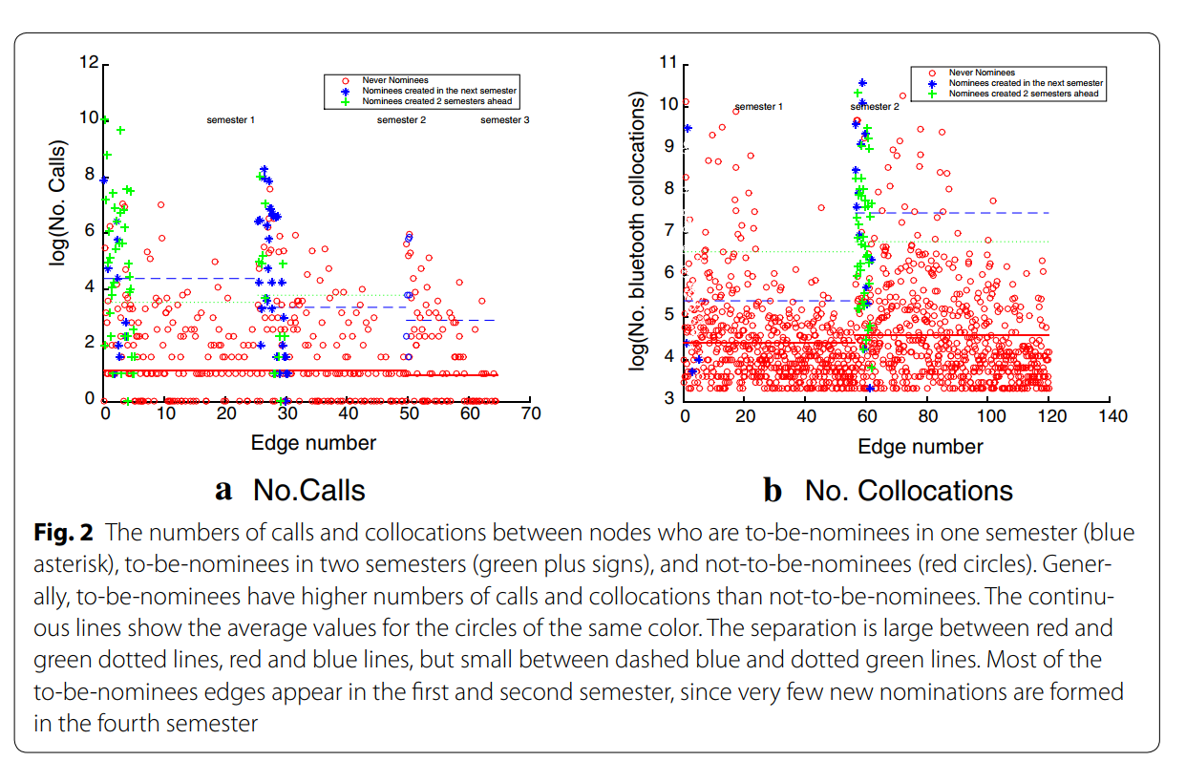
NetSense data as a multilayer network

Slide 28
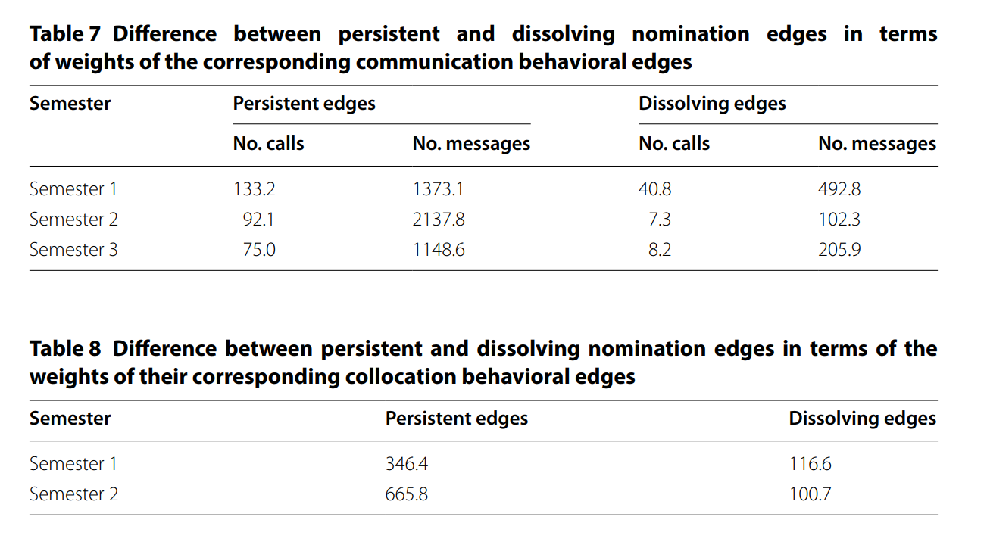
NetSense data as a multilayer network

Slide 29
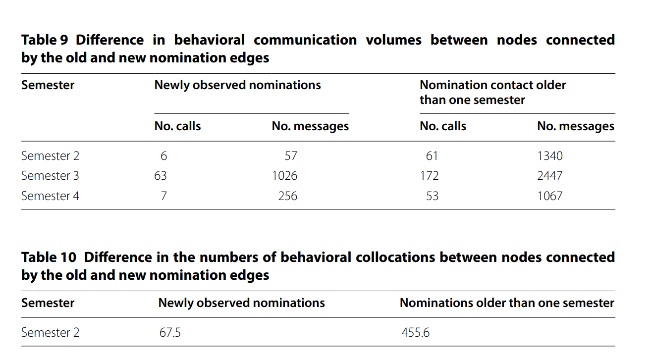
NetSense data as a multilayer network

Slide 30
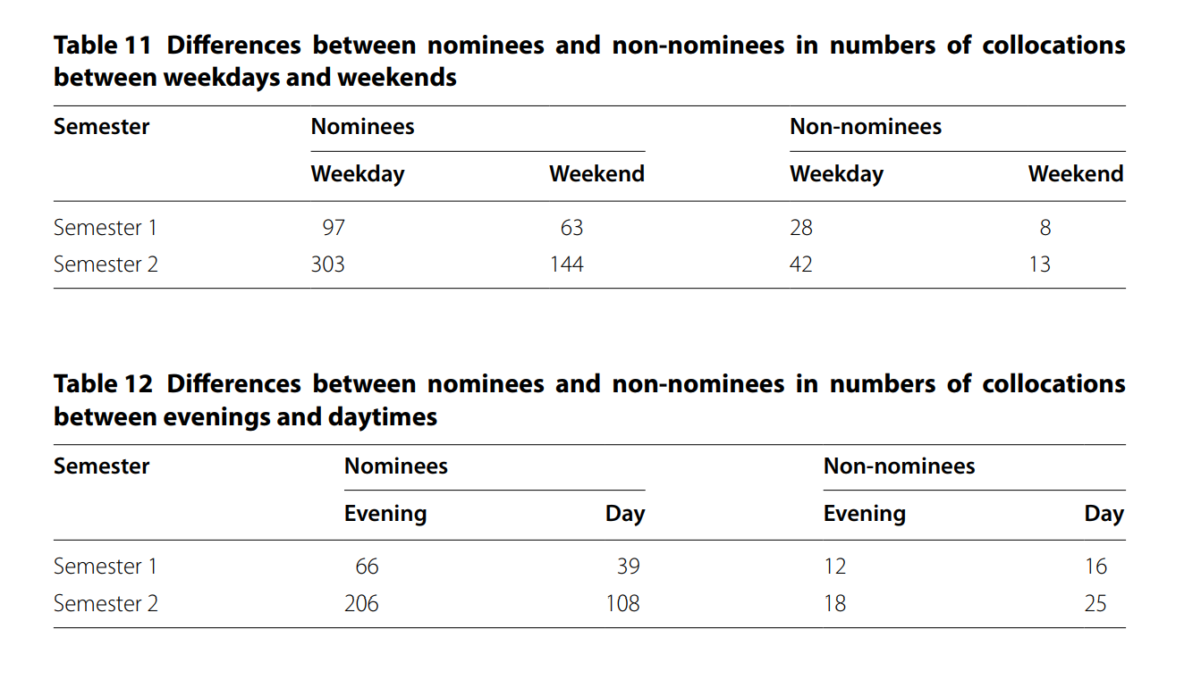
NetSense data as a multilayer network

Slide 31
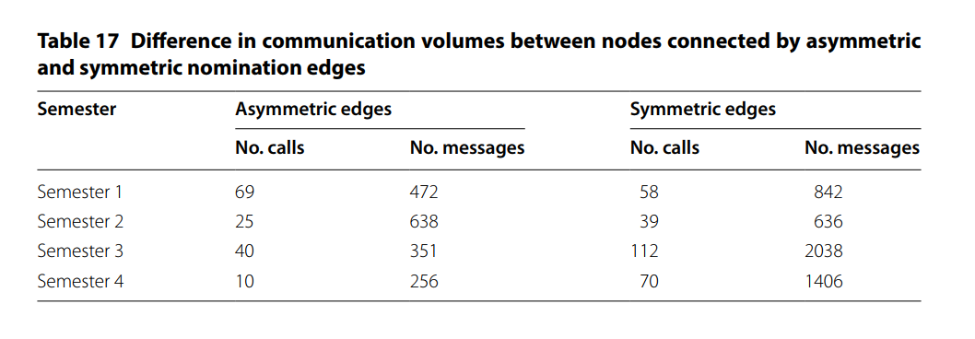
NetSense data as a multilayer network
Data collected as part of NetSense can be thought of as node-aligned multilayer network
  We may be interested in:
    Cross-layer correlations
    Cross-layer temporal dependence
    Cross-layer topological similarities and differences

